Slide 1





KICKSTART YOUR SUCCESS
DATA-DRIVEN STRATEGIES FOR A WINNING CAMPAIGN
Prepared by:
Ali Al-Ansari
Mohamed Jamal Alqallaf
Qasim Al-Qatari
Mariam Azam

Slide 2




HELPING CREATORS SUCCEED:
THE PROBLEM & OUR MISSION
Our client wants to launch a Kickstarter campaign but is unsure how to structure it for success — from choosing the right category to setting goals and engaging backers.
This project aims to analyze key trends in Kickstarter data and deliver clear, strategic recommendations to help design a campaign with a higher chance of success.

Slide 3
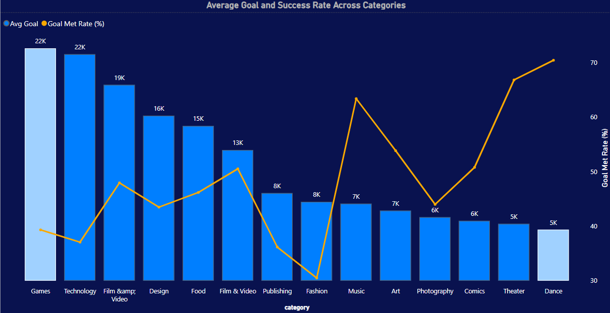
SUCCESS RATES ACROSS KICKSTARTER PROJECTS
BY CATEGORIES AND FUNDING GOALS
Some categories consistently outperform others in success rates, meeting or exceeding their goals, giving insight into safer bets for new campaign creators

Slide 4
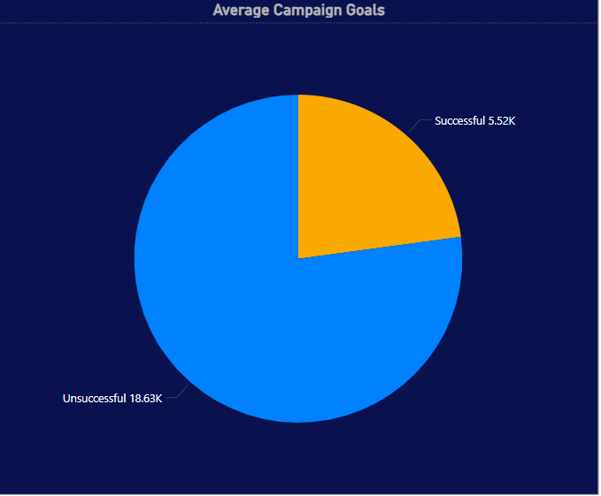
SETTING THE RIGHT TARGET:
GOALS IN SUCCESSFUL VS. UNSUCESSFUL CAMPAIGNS
Successful campaigns tend to set more achievable funding goals, suggesting that setting realistic targets may increase the likelihood of being fully funded

Slide 5
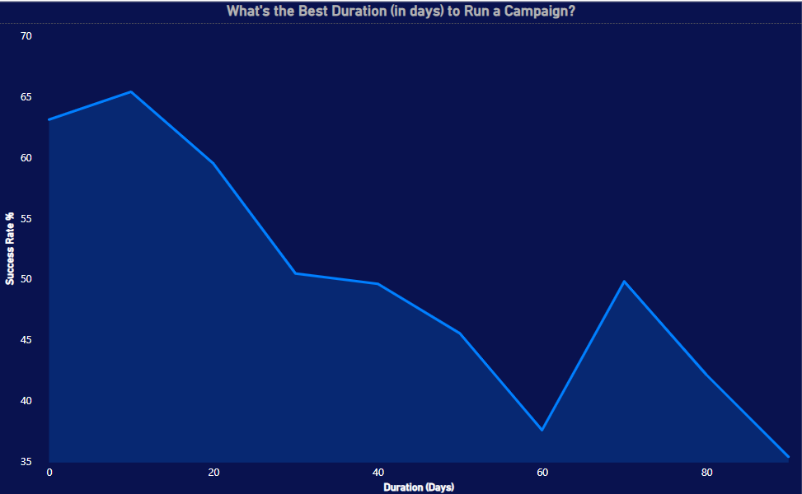
TIME VS. SUCCESS:
WHAT’S THE IDEAL CAMPAIGN LENGTH?
Campaigns with optimal durations perform significantly better —
too short may limit reach, too long may lose momentum

Slide 6
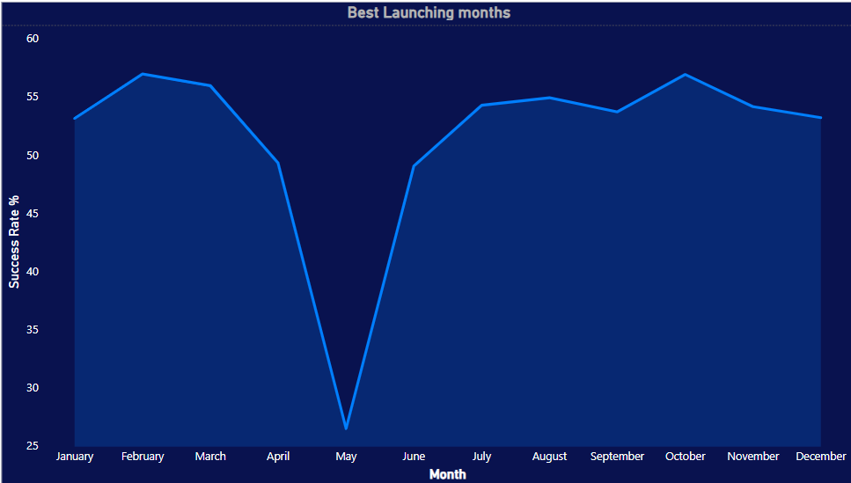
SEASONAL STRATEGY:
WHEN TO LAUNCH FOR MAXIMUM IMPACT?
Launch timing can influence success — certain months show consistently higher funding rates and backer engagement

Slide 7
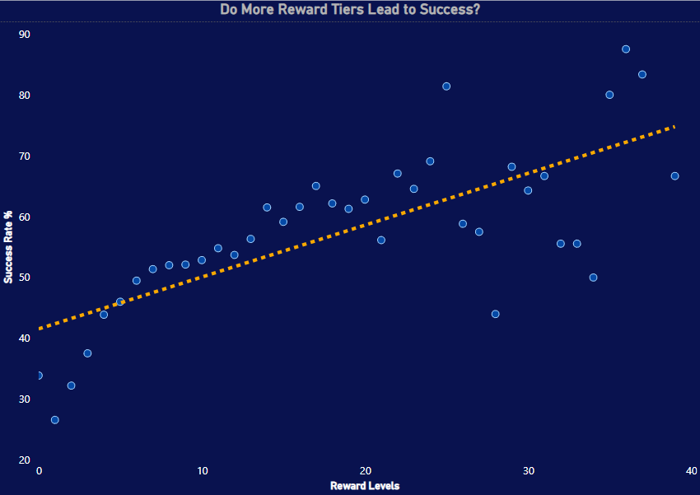
ANALYZING THE ROLE REWARD TEIRS IN
CAMPAIGN PERFORMANCE
The data indicates a positive trend: successful campaigns tend to offer more reward levels than unsuccessful ones

Slide 8

FROM INSIGHT TO ACTION:
OUR FINAL RECOMMENDATIONS
Category Selection
Focus on high-performing categories - such as Dance, Theatre, Music- which show consistently high success rates.
1
Funding Goal
Successful campaigns tend to aim lower than failed ones — staying within a goal range of [$5000-5550] increases your likelihood of success.
2
Campaign Duration
The most successful campaigns typically run for 20-40 days - long enough to gain traction, short enough to maintain urgency.
3
Launch Timing
Launch your campaign during the first quarter or second half of the year - when activity and backer engagement are at their peak.
4

Slide 9
DATASET LIMITATIONS
Outdated Data:
The dataset contains campaigns from earlier years, which may not reflect current platform algorithms, user expectations, or industry trends.
1
Category Imbalance:
Some categories have far more campaigns than others, potentially biasing conclusions toward overrepresented project types.
2
Lack of Behavioural Metrics
We don’t have data on user behavior (e.g. views, click-throughs, time on page), which limits our ability to understand what truly drives engagement.
3
External Influences:
Dataset doesn’t account for external marketing efforts, social media presence, or creator reputation, which strongly impact success.
4

Slide 10
THANK
YOU

